Slide 1

Hands-on-Workshop
Toronto
Danilo & Jo
21 June 2017

Slide 2

Notes:
discrete
combinatorially explosive / not tractable

Slide 3
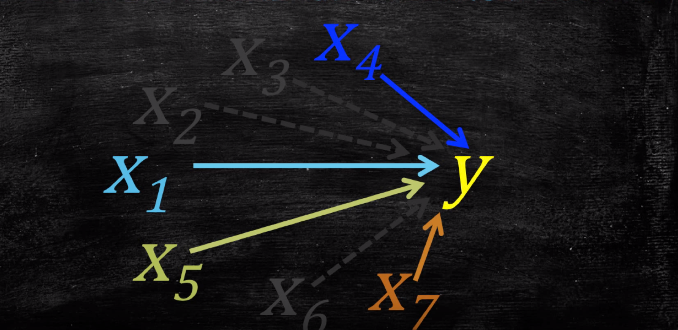
Notes:
Problems:
we are too strict (variable units) and arbitrary in choosing variables
by dropping variables we might loose information that can explain variance related to y

Slide 4
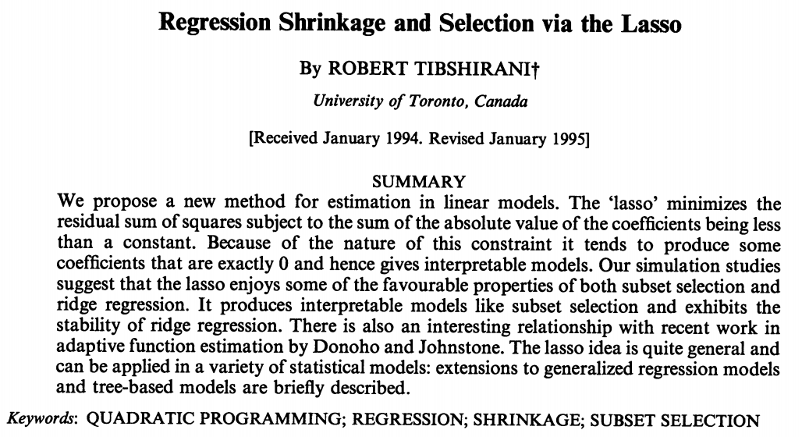
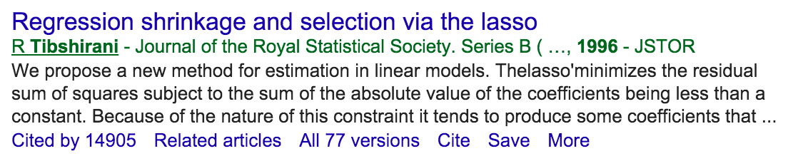

Slide 5


Slide 6

https://www.youtube.com/watch?v=m60lVGz34hU

Slide 7
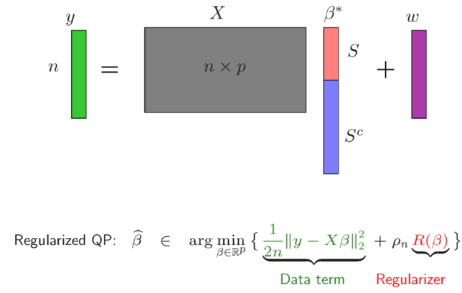

Slide 8

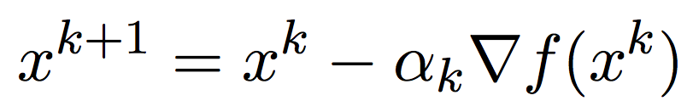

Slide 9
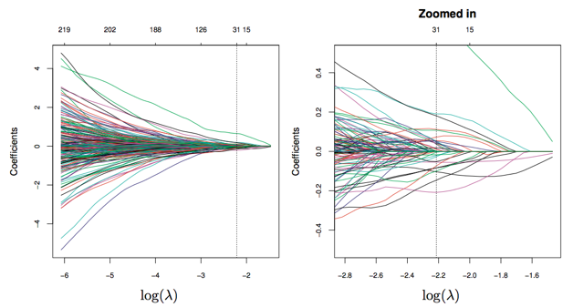

Slide 10
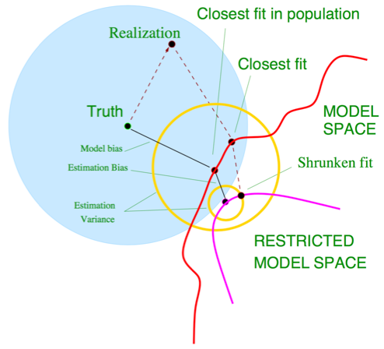

Slide 11
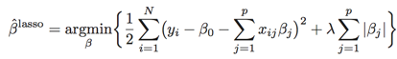
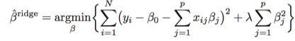
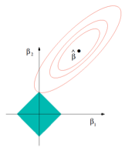
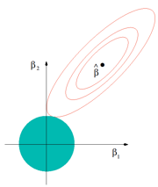
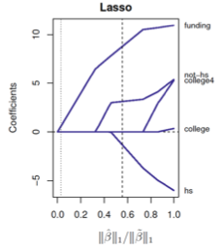
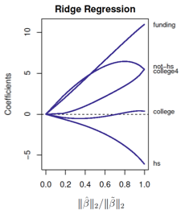
Lasso
RidgeRegression
Notes:
Intercept:
also known as the bias in machine learning
s a constant term that is not multiplied by the data X.
b) If your data are mean-centered (mean zero) then the intercept will be zero -> I wouldn't need the intercept because the final solution would be the same
c) If your data is not mean-centered, then the intercept accounts for it by adding an additional estimation bias
Hastie: In practice, we can ignore the intercept, since in practice we can center all the variables and the response and it goes away
L1: shrinkage + selection
- Lasso is the closest convex relaxation of the best-subset selection problem
- Lasso is a fitting procedure that can be called "adaptive"
impetus after Tibshirani (1996) proposed the least absolute shrinkage and selection operator (or lasso)
The value q = 1 is the smallest value that yields a convex problem.
- Hastie: L1 penalty (used in Lasso) can be used for variable selection and shrinkage with any linear regression model, e.g. also logistic regression
- CAVE when many correlated parameters -> L1 is indifferent to choosing one of them (i.e. non-zero) and dropping the rest (i.e. zero); that is, if there are a lot of correlated variables (such as genomics because of related pathways) this behavior of L1 might impede interpretability as biologically meaningful information was lost
a) computational advantages (convex)
b) fit model is more interpretable
c) “bet on sparsity” principle
- behavior is somewhat between Ridge and best subset selection
L2: shrinkage
all parameters are non-zero -> does not perform feature selection (<=>L1) -> does not lead to sparse solutions (<=>L1)
shrinks parameters of correlates variables/features towards each other
coefficient are shrunk towards a) zero and b) each other
- L2 term IS differentiable -> more optimization techniques apply
shrinks low-variance directions first
ridge shrinks the coefficients of all redundant variables so that the total contribution is well-balanced, whereas the lasso tends to drop all but one of the redun- dant variables.

Slide 12
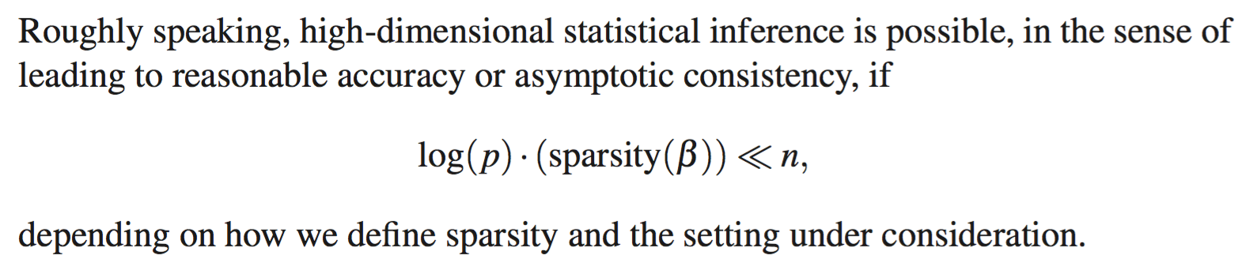
Bühlmann et al., 2006

Slide 13
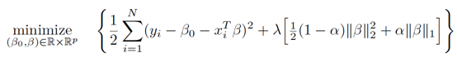
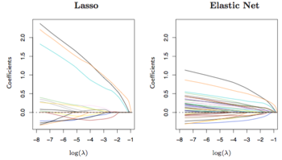
ElasticNet
Notes:
Is not a classifier but a penalty!! It is actually a mixture of L1/Lasso and L2/RidgeRegression penalties.
it is a generalization of the Lasso (inherits selection and shrinkage)
-> ElasticNet selects features such as Lasso, and shrinks together the parameters of correlated features like Ridge
- The elastic net penalty is a convex combination of the ridge and lasso penalties.
in the presence of highly correlated variables, the Lasso can show erratic and even wild behavior (coefficients for extremely correlated variables are not defined) -> MOTIV for ElasticNet
- induces more non-zero parameters as Lasso, but with smaller magnitude
The most relevant disadvantage is that the number of variables selected by the lasso is limited by the number of observations. For example, if applied to microarray data where there are thousands of predictors (genes) (p > 1000) with less than 100 samples (n < 100), the lasso can only select at most n genes, which is clearly unsatisfactory. alpha is a higher level parameter that can be set on subjective grounds
- L1 term alone is convex; L2 term alone is strictly convex; L1 + L2 is strictly convex !

Slide 14
How can be test whether
a selected variable is statistically significant?

Slide 15
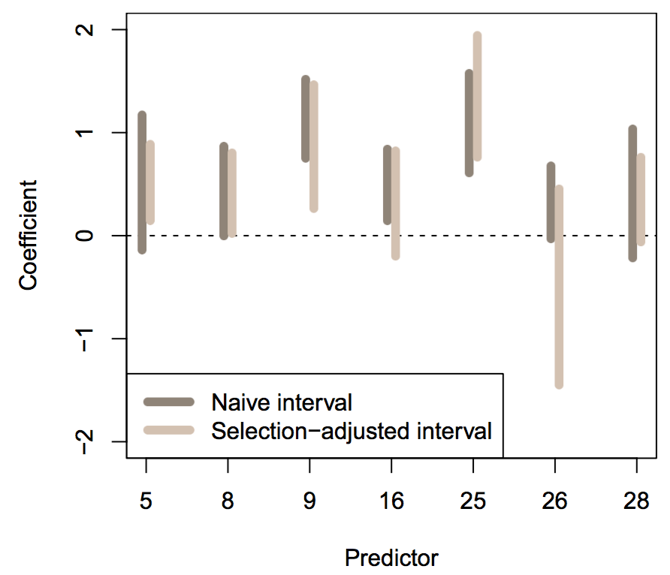
Perspective: Post-selection Inference
Tibshirani et al., 2015 PNAS

